Slide 1
Classroom management:
Teacher-student relationship
CRMEF -Tangier
The English Department
Trainer: Rabia El Antaki

Slide 2
Warm up: Rose-Thorn-Bud (5mn)
Rose = A highlight, success, small win, or something positive that happened.
Thorn = A challenge you experienced or something you can use more support with.
Bud = New ideas that have blossomed or something you are looking forward to knowing more about or experiencing.
https://www.mindfulschools.org/inspiration/mindful-reflection/

Slide 3

Reflection??? (10 mn)
Effective teacher-student relationships have nothing to do with the teacher's personality or even with whether the students view the teacher as a friend. Rather, the most effective teacher-student relationships are characterized by specific teacher behaviors: exhibiting appropriate levels of regulation; exhibiting appropriate levels of cooperation; and being aware of high-needs students.
Merzano

Slide 4
Learning outcomes
By the end of this session, you will be able to
Define what a relationship is
Identify behaviors that might impact negatively the teacher-student relationship
Identify features of a healthy teacher-student relationship
Construct your own guidelines liable to assist you in establishing a successful relationship with your students
By the end of this session, you will
Define concepts
Reflect on some real cases
Interact synchronously on Google classroom
Exchange views about successful teacher-student relationships

Slide 5
What is a relationship?
(5mn)
What is a relationship?

Slide 6
Marriam webster
the way in which two or more people, groups, countries, etc., talk to, behave toward, and deal with each other
the way in which two or more people or things are connected

Slide 7
What verbs could you identify from this definition? (5 mn)

Slide 8
Talk to each other
Behave towards each other
Deal with each other
The way to connect to each other

Slide 9
What can cause a teacher-student Relationship breakdown? (5mn)
What can cause a teacher-student Relationship breakdown? (5mn)

Slide 10
Case study 1 (10 mn)
I had that teacher in primary school in whose class we could not move. We were stuck to our desks and we did whatever she told us to do. If anyone did not, she would punish them.

Slide 11
Case study 2 (10 mn)
My French teacher usually told me that I had a low level compared to my classmates. Before the exam, she used to tell me that If I could have 10/20 , that would be great. So I never had a better mark than 10. and when I needed help, she told me that things were too hard for me to grasp.

Slide 12
Case study 3 (10 mn)
This was my 9th grade teacher. He was too friendly and really familiar. He considered us as peers and used to give us too much latitude. He was also very lenient

Slide 13
Case study 4 (10 mn)
I had a teacher in high school who did not show any interest in whether I pass or fail my examinations. So, I did not show any interest myself in the subject.

Slide 14
Case study 5 (10 mn)
One of my male teachers had a weird behavior with one of my friends. He usually told her she was beautiful and never penalized her for a homework she did not do while he behaved differently with us.
I learned later that he was fired from school.

Slide 15
Behaviors Inappropriate to the Teacher-Learner Relationship

Slide 16

Behaviors which demonstrate disrespect for others or lack of professionalism in interpersonal conduct

Slide 17
unwanted physical contact (e.g. hitting, slapping, kicking, pushing) or the threat of the same
loss of personal civility including shouting, personal attacks or insults, displays of temper (such as throwing objects);

Slide 18
sexual harassment (including romantic relationships between teachers and learners in which the teacher has authority over the learner’s academic progress) or harassment based on age, gender, race, ethnicity, national origin, religion, disability or sexual orientation

Slide 19
requests for others to perform inappropriate personal errands unrelated to the didactic or investigational, situation at hand

Slide 20
grading/evaluation on factors unrelated to performance, effort, or level of achievement.

Slide 21
What other characteristics would accentuate teacher-student breakdown ?
Unfriendly
Too friendly
Unhelpful
A bully
Unfair
Immoral

Slide 22
What elements constitute a successful relationship?

Slide 23
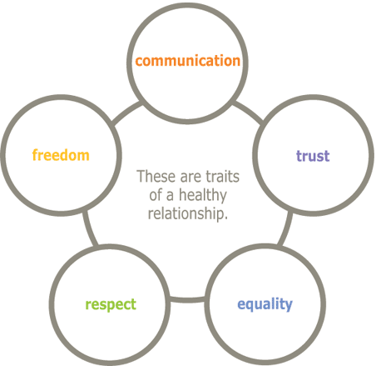

Slide 24
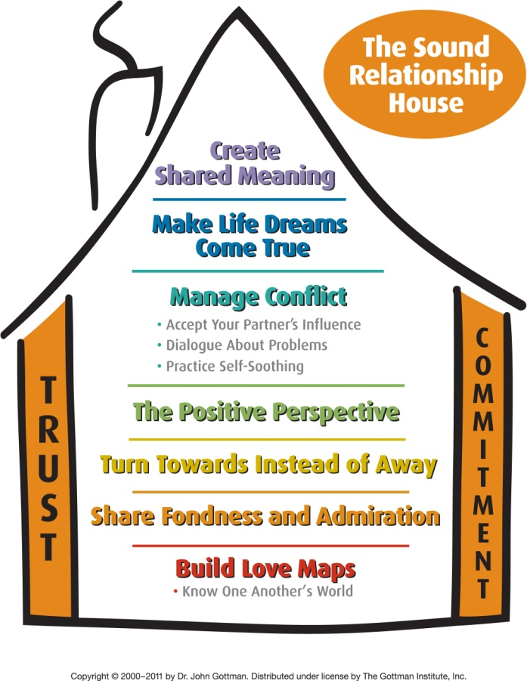

Slide 25
Impacts of a healthy relationship between teachers and students
It has an impact on how a student’s performance is
Students are more willing to learn when they like and respect their teachers
Teachers have more job satisfaction and feelings of contentment

Slide 26
Homework
Provide 6 guidelines for an appropriate conduct in a teacher-student relationship

Slide 27
Homework submitted by Jihane Fericha. CRMEF Tangier
Be fair. Treat all students in the same way and give each students what he/she really deserves because students are very intelligent and they may notice when the teacher is favoring or treating differently some students.
Be consistent and professional. A teacher should build a strong relationship with his/her students and be close to them, at the same time he/she should set limits starting from day one. He/she should build his/her image as a confident teacher worthy of respect and attention.

Slide 28
Homework submitted by Jihane FerichaHomework submitted by Jihane Fericha. CRMEF Tangier
Be a role model. Behave wisely in the classroom and choose the appropriate manner to treat your students in order to get mutual respect. Never let your students see you frustrated or out of control and make them feel proud of you and happy for having such a great teacher. Some teachers really can have a positive impact on their students and those students may consider their teacher as a motivator and cultivate an ambition to study and become like them.
Be passionate and patient. Teach your students with passion and always be updated to avoid routine. The variation of methods and techniques will make students more interested in the subject. Giving students a good impression from the beginning may help in avoiding some disruptive behaviors and problems which can prevent students’ progress.

Slide 29
Homework submitted by Jihane FerichaHomework submitted by Jihane Fericha. CRMEF Tangier
Let your students know that you love them and care about them. Make students feel that you are a hard worker and all what you do is for their benefit. Students recognize the teacher who is doing his best and the teacher who is just wasting time. Demonstration of love is to show your students that you enjoy your work while teaching them. For example being on time, making learning fun, engaging student, all this has a positive impact on SS. Do not become so burned out teacher to the point of that you ignoring your students and becoming an inhuman person because students need you and they may come to ask for advice if they are close to you and trust you.
Always open the floor for communication. By communicating you can discover what your students’ needs are. Communication is an opportunity to discuss, give and receive feedback in order to find solutions for things that make us both teachers and students unsatisfied. Therefore, this will help you as a teacher to build a good rapport with your students.

