Slide 1
Managing a teaching-learning situation
Learner-centeredness, Groupings and interaction patterns
CRMEF -Tangier
The English Department
Trainer: Rabia El Antaki

Slide 2
Learning outcomes
By the end of this session; you will
Learn the shift in the teaching-learning process
Learn different groupings and interaction patterns
Provide different activities that allign with each pattern
Identify advantages and disadvantages of interaction patterns

Slide 3
A teacher-centered approach?
For centuries, learners have been subject to a teacher-centered approach that is mainly characterized by
  Hierarchy,
  authority,
  transmission,
  memorisation
  rote learning
  Direct instruction

Slide 4
Direct instruction
Teacher being actively engaged in bringing the content of the lesson to the whole class (Muijs and Reynolds, 2011)

Slide 5
However, a substantial shift of the center of instruction has occured with the works of some theorists like John Dewey, Jean Piaget and Lev Vygotsky, who focused the learner as the main agent in the teaching-learning process.

Slide 6
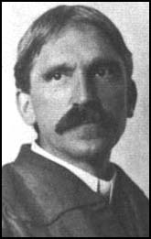
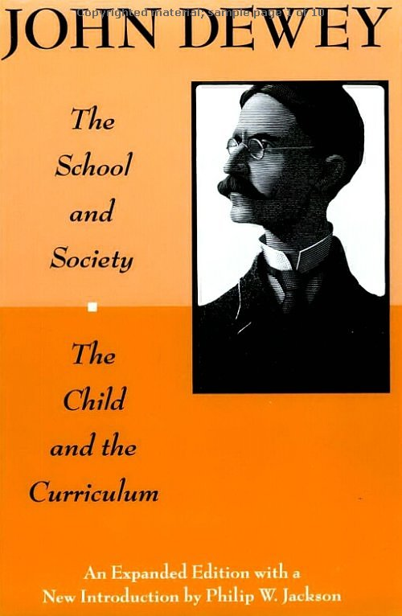
the progressivist revolution
“Now the change which is coming into our education is the shifting of the center of gravity... the child
becomes the sun about which the appliances of education revolve; he is the center about which they are organized.”
John Dewey
1859-1952

Slide 7
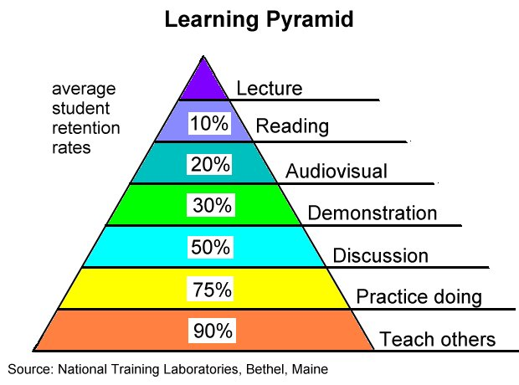
The amount of learning is believed to be intimately related to the way used in instruction as the following pyramid demonstrates

Slide 8
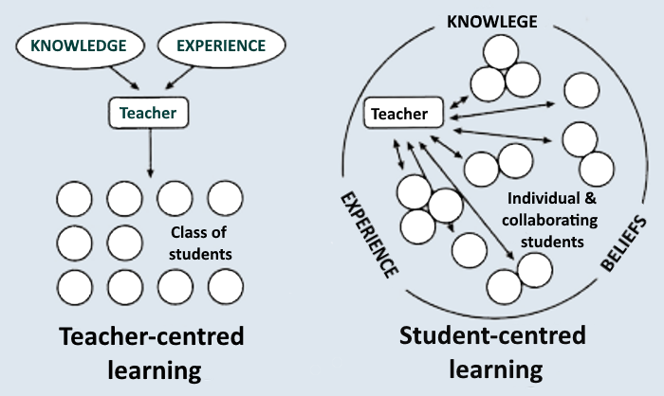
In direct instruction or a teacher-centered approach, the learners are exposed to one set of beliefs, one kind of knowledge and one unidimentional experience. On the other hand, when the center is the student/s, the ineraction patterns are widened and students can learn from the teacher, or from each other. Besides, the teacher himself/herself becomes a participant who can also learn from students as everybody is exposed to each other’s knowledge, beliefs and experiences.

Slide 9
Groupings and ineraction patterns
Learner centeredness presupposes interactions between teacher and students and interactions among students themselves.

Slide 10
Interaction patterns
IRF: one of the most used
I: initiation
R: response
F: feedback
The teacher starts by asking a question, a student responds, the teacher provides feedback

Slide 11
Interaction patterns
TT = here the teacher is very active, the students only basically receptive
T =Teacher is still active, students are mainly receptive
TS =Teacher and students fairly equally active S =Students active, teacher mainly receptive SS =Students very active, teacher only receptive

Slide 12
Further reading
You will be provided with a piece of reading on patterns of interactions to have a clearer idea of how they work and kind of activities you might implement in each pattern.

